Slide 1
JIRA DATA CENTER
An Overview

Slide 2
FEATURES
High availability
JIRA Data Center achieves High Availability via a multi-node cluster where-by all nodes are active.
Performance at scale
Each node added to your JIRA Data Center cluster increases concurrent user capacity and improves response time as user activity grows.

Slide 3
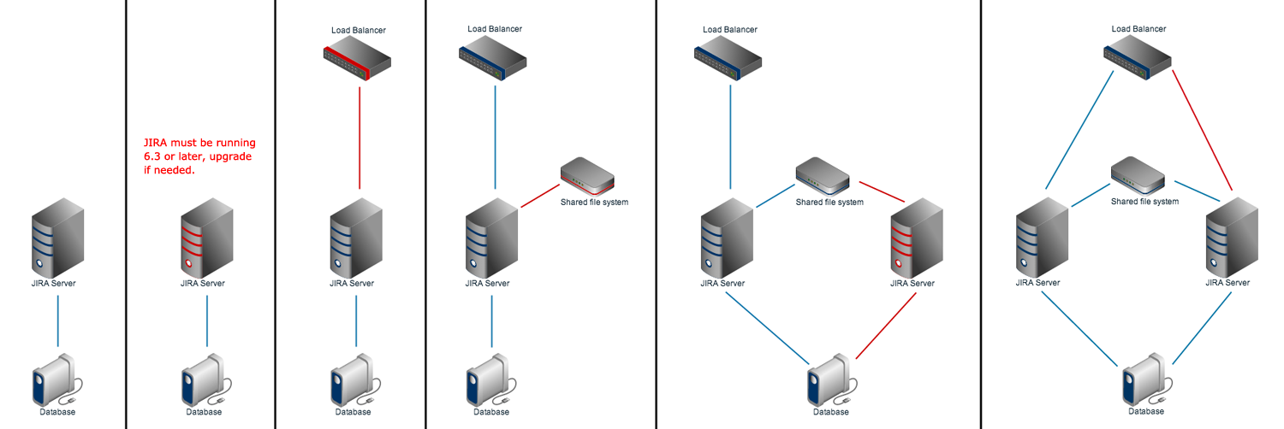
DIAGRAMATIC REPRESENTATION
Notes:
To emphasize on the data-flow aspects, an over-simplified representation of the architecture is shown here.

Slide 4
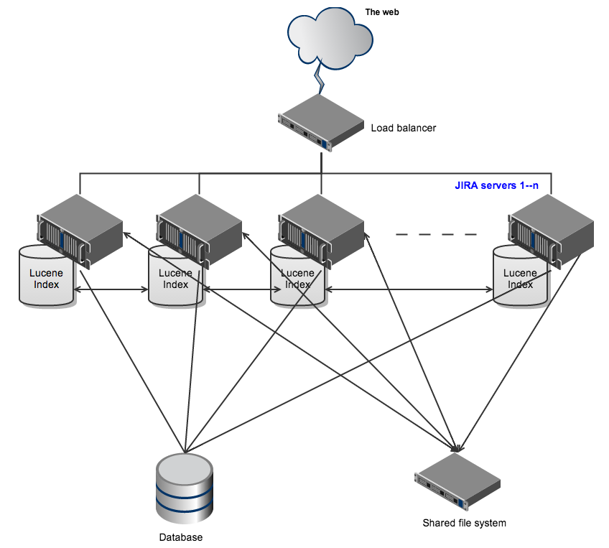
ARCHITECTURE

Slide 5
Load Balancer
You can use any load balancer that supports session affinity.
Application node
JIRA instance all talking to the same database but with its own index (the complete index is replicated on all nodes)
This enables instant failover in the event of an outage and index recover in case the index in a node becomes corrupted..
Database
JIRA Data Center supports the same databases that are supported for JIRA

Slide 6
Shared Storage
All the nodes should have read and write access on Shared file system.
There are multiple ways to do this, but the simplest is to use an NFS share
which stores:
Export files
Import files
Plugins
Logos directory
Shared caches
Data directory which includes:
  Attachments
  Avatars
  Icons

Slide 7
INSTALLING JIRA DATA CENTER
Upgrade your JIRA instance to 6.3 or later
Set up the JIRA file storage location on shared storage
EG : /data/jira/sharedhome
Copy the following directories into /data/jira/sharedhome
Data,plugins,logos,import,export
Configure your existing JIRA instance to work in a cluster
Put a cluster.properties file in the local JIRA home directory, with contents as follows:

Slide 8
# This ID must be unique across the cluster
Jira.node.id= node1
# The location of the shared home directory for all JIRA nodes
jira.shared.home = /data/jira/sharedhome
Add the first node to your load balancer
TBD
Add a new JIRA node to the cluster
Copy installation and Home directory folders to new location
Alter the cluster.properties file to reference the new node id. All node ids must be unique among nodes.
Connect this new node to the load balancer
TBD

Slide 9
DISASTER RECOVERY
Can be achieved with JIRA Data Center 6.4 or higher
https://confluence.atlassian.com/display/ENTERPRISE/Disaster+Recovery+Guide+for+JIRA

Slide 10
RECOMMENDATIONS
Each JIRA node must run on its own machine (physical or virtual), with a separate machine for the shared services. The shared services machine must be accessible by each node.
Nodes must be configured with the same timezone and keep the current time synchronized.
User needs to relogin if node gets inactive, we recommend users check the “Remember me”.
Please also note that session based tasks such as 'bulk edit' will need to be restarted if a node goes down during the task
Tasks can be scheduled to run in all nodes or in one node only.

Slide 11
LICENSE COST
Data Center is an annual term license per Data Center instance and is $24,000 for every 1,000 users. Data Center licenses do expire and are not perpetual like our server licenses.
Upgrading existing jira license
From 501-2,000 Users | US $16,000
You can refer below
https://www.atlassian.com/licensing/data-center

Slide 12
PAIN POINTS
Plugin Compatibility.
Jira Service Desk Compatibility.
Periodic Upgrades.
Plugin Development Process.

